Slide 1
PRACTICE EXERCISE 3 – SEPTEMBER 2022
Dra Jelena Bobkina

Slide 2
MADRID
PRACTICE EXERCICE 3 ACTIVITY 1

Slide 3


Slide 4
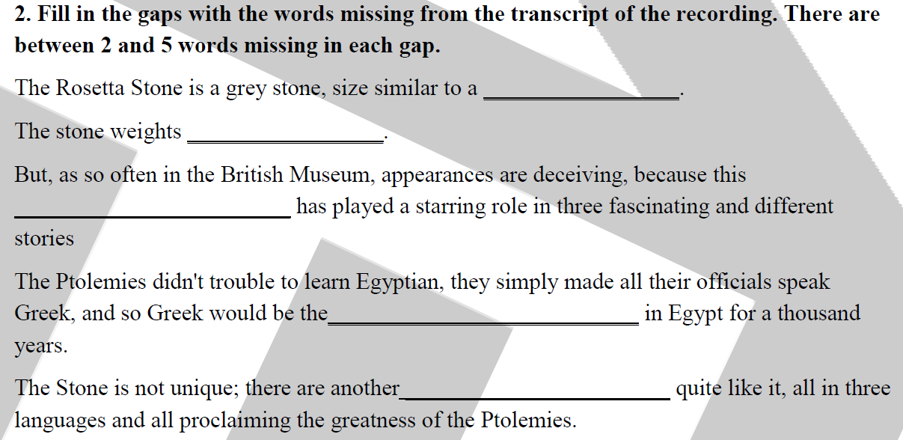

Slide 5


Slide 6

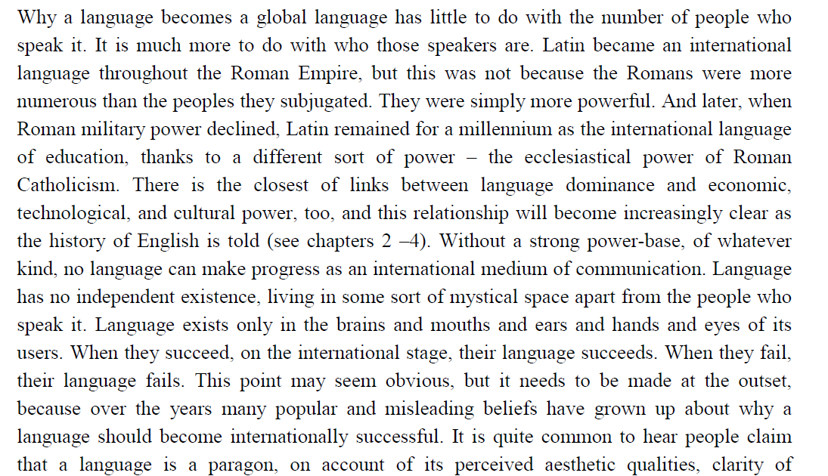

Slide 7
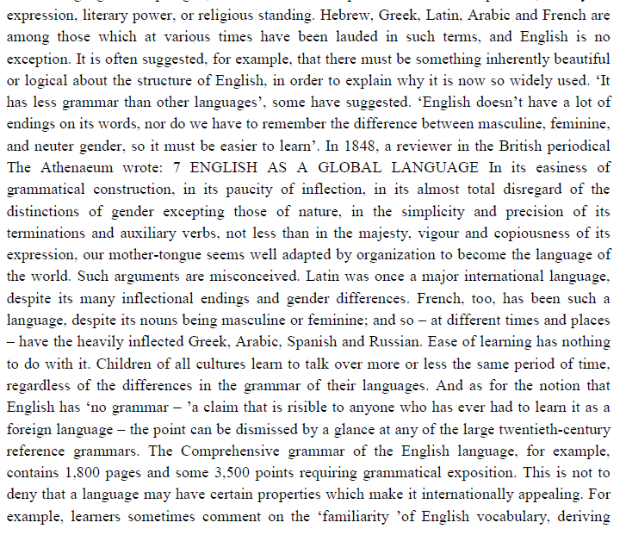

Slide 8
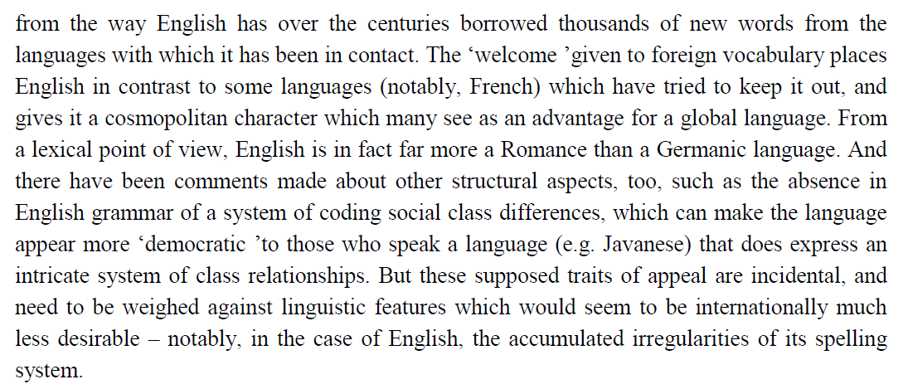

Slide 9
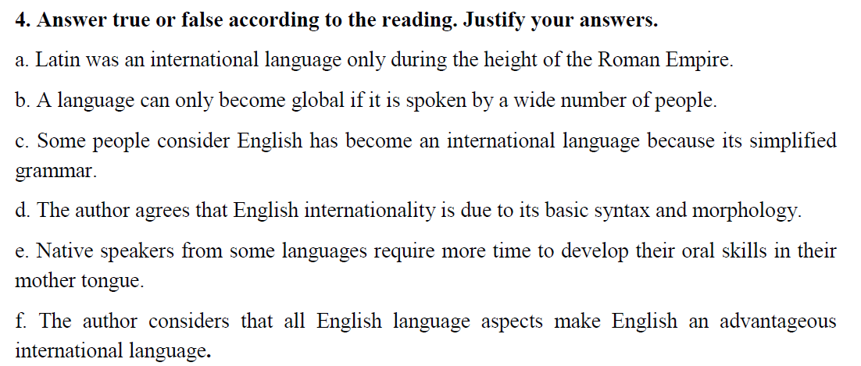

Slide 10


Slide 11
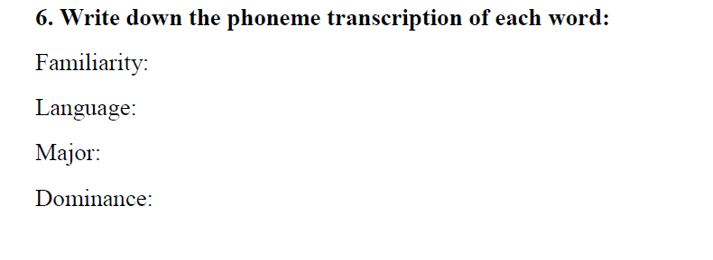
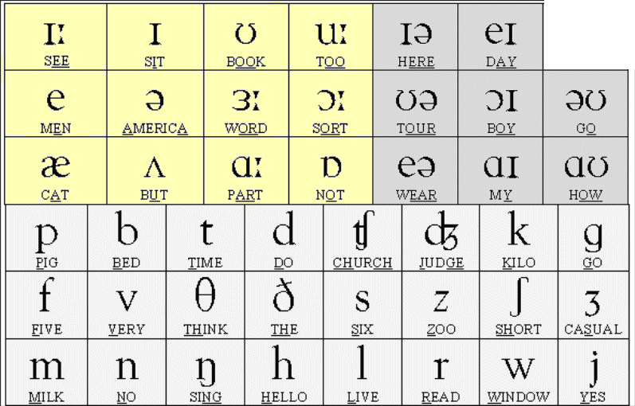
https://www.esl-lounge.com/student/pronunciation.php

Slide 12
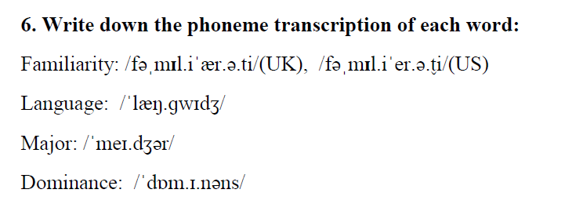

Slide 13
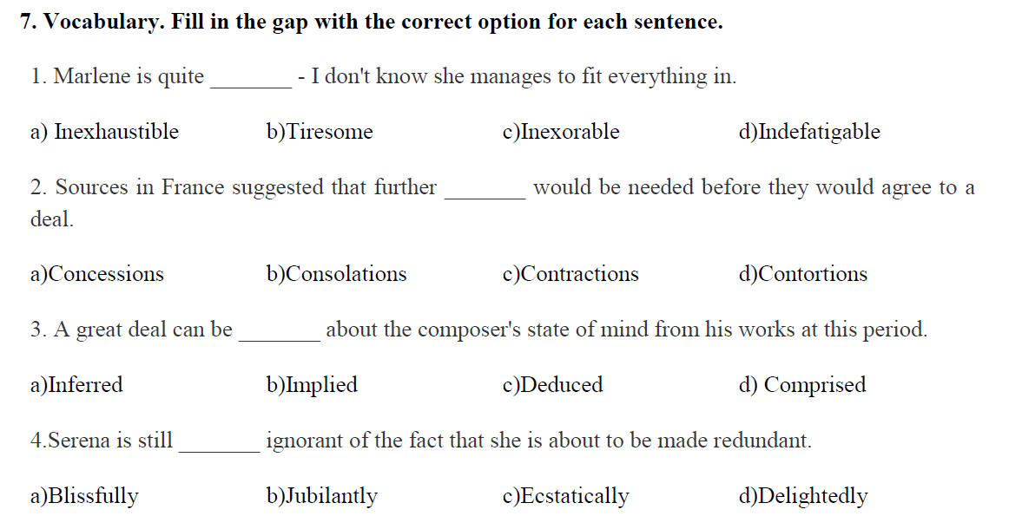

Slide 14
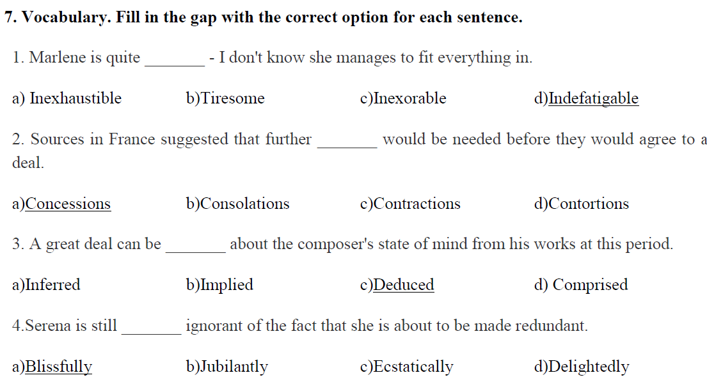

Slide 16
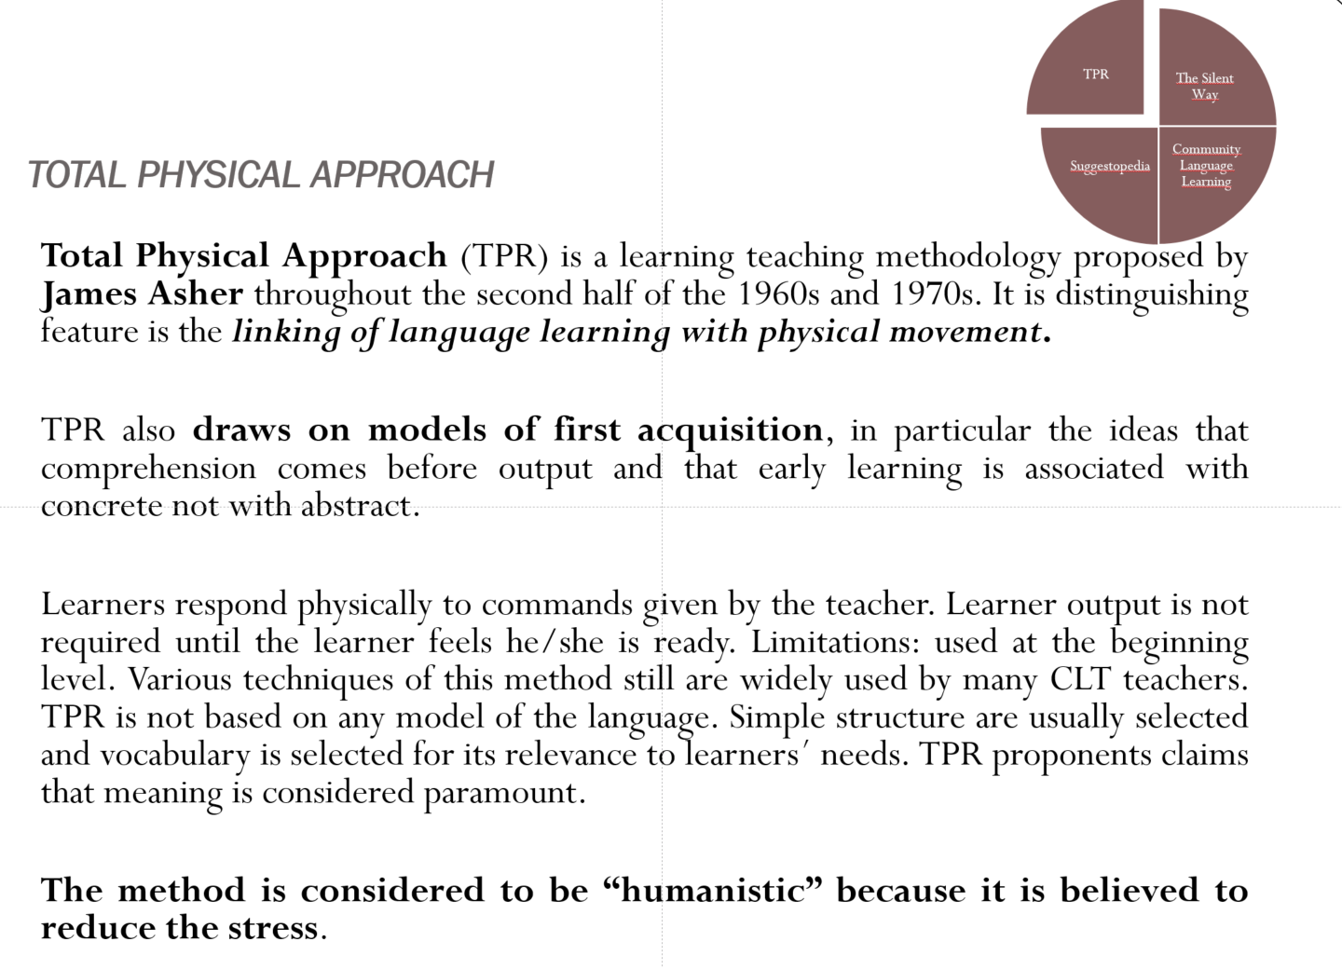

Slide 17



