Slide 1
PRACTICE EXERCISE 1 – SEPTEMBER 2022
Dra Jelena Bobkina

Slide 2
MADRID
PRACTICE EXERCICE 1 ACTIVITY 1
LISTENING: Listen to Naom Chomsky´s talk “educational system” and answer the questions below:

Slide 3
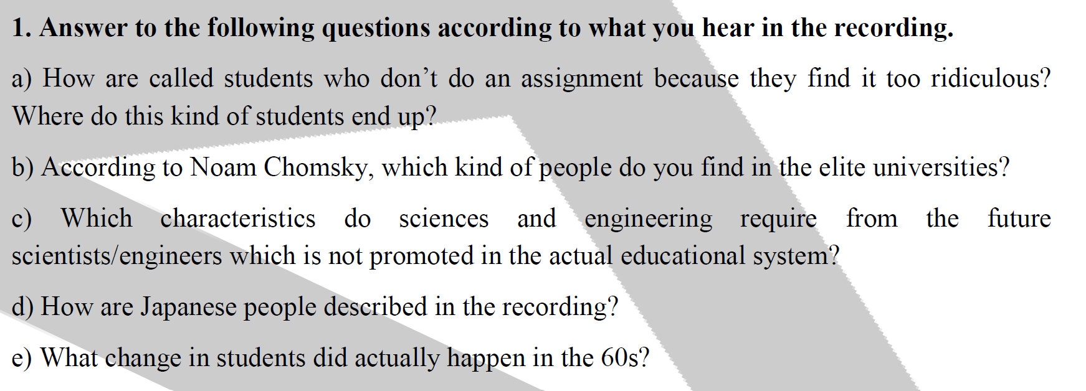

Slide 4
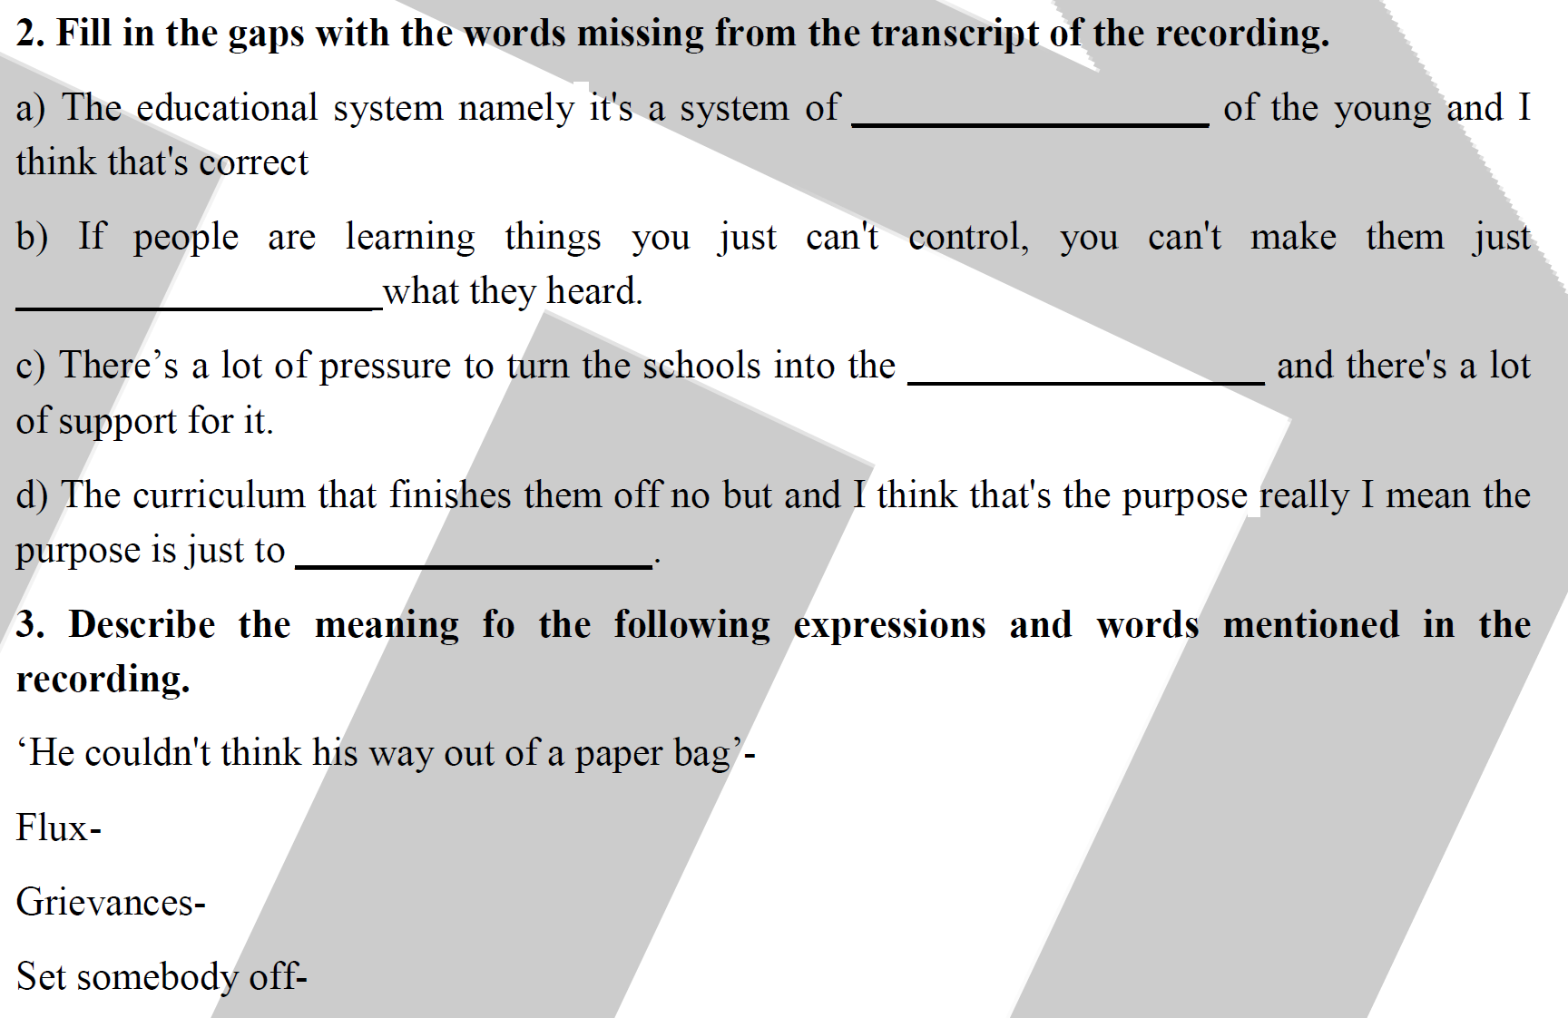

Slide 5
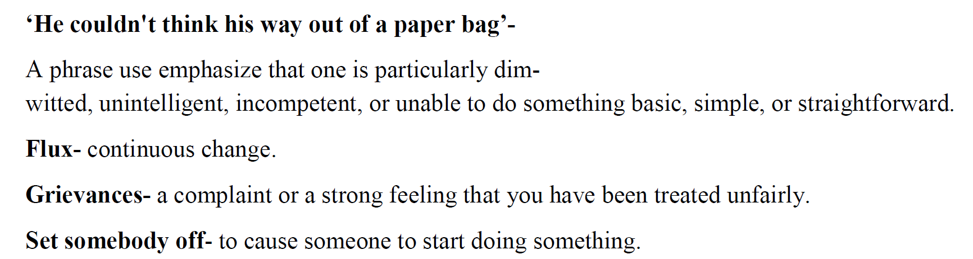

Slide 6
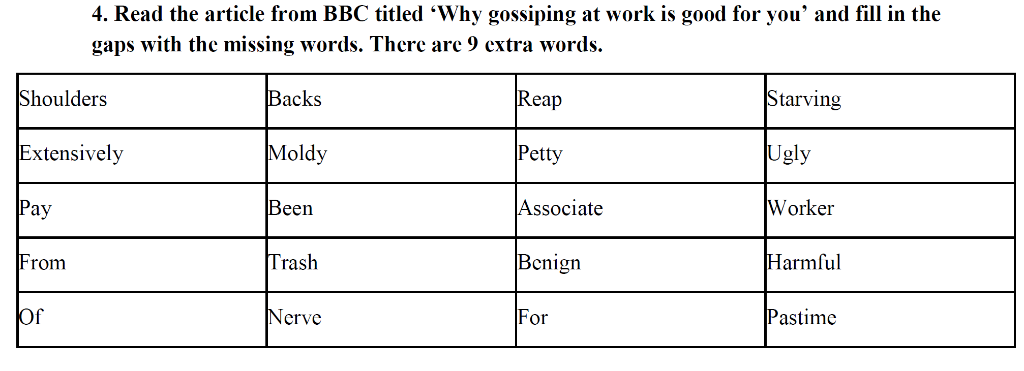

Slide 7
‘Why gossiping at work is good for you’
Gossiping at work is generally frowned upon. But research shows that we can 1. _______ benefits by leaning into harmless office chit-chat.
There are many things we might miss about working in the office: free coffee, free air conditioning, an excuse to wear something other than sweatpants.
But the thing we might miss the most is other people – and our conversations with them. Specifically, how Mike’s partner just had another baby, how the fridge is filled with Jane’s 2. _________ old lunches, that the IT help desk is as slow as ever and how the boss gave Mark and not Jean that 3. _________ rise. In other words: gossip.
While some gossip can be 4. _________ and unprofessional, other types of gossiping can be fun, normal, even healthy and productive. Experts say that talking about others behind their 5. _________ doesn’t have to be a guilty office 6. _________ – it can be a useful tool to navigate the workplace and learn important information.
“I think, generally, gossip is a good thing,” says Elena Martinescu, a research 7. _________ at Vrije Universitetit Amsterdam, who’s 8. _________ studied the psychology of gossiping. “According to evolutionary theory, humans have developed gossip in order to facilitate co-operation in a group.”
shoulders | extensively
pay | from
of | backs
moldy | trash
nerve | reap
petty | associate
benign | for
starving | ugly
worker | harmful
pastime

Slide 8
By talking about other people, we can learn whom to collaborate with and whom to stay away 9. _________, something that helps a group work better together. This ingrained behaviour translates to the modern workplace, she says, “where it is equally important to be aware of which colleagues one can trust and who one should be careful with”.
Matthew Feinberg, a professor of management at the University of Toronto, who’s also studied gossip, points out that there are different types of gossip. “When gossip is just ‘talking 10. _______ –’commenting on someone's appearance for example – that serves no positive purpose, and therefore is negative, damaging and problematic.” But research shows that most gossip is pretty 11. _________.
A 2019 study, for example, showed that when researchers recorded conversations of around 500 participants, the vast majority – more than three-quarters – of the conversations weren’t positive or negative, but neutral. It could be banal information travelling through the grapevine, like ‘I heard Mary’s daughter is majoring in marketing ’or ‘Pete is on holiday in Cornwall’. So even though the same study showed that we gossip a lot – an average of 52 minutes a day, in fact – the content is largely not as salacious as we assume.
“I think the biggest misconception is that gossip is always this negative cattiness – talking badly about somebody behind their backs. But surveys suggest that the primary reason people do it is because they really just want to make sense of their environment,” says Shannon Taylor, a professor of management at the University of Central Florida, US, who studies workplace dynamics.
shoulders | extensively
pay | from
of | backs
moldy | trash
nerve | reap
petty | associate
benign | for
starving | ugly
worker | harmful
pastime

Slide 9
Gossip can “validate our emotions” and help us figure out where other people stand on things, he says, and that gossip helps us make sure if the way we’re “perceiving the world in the same way as other colleagues and coworkers receive it. It’s really about information gathering.” So, if someone at work says something like “Ralph has been taking a lot of sick leave recently,” it could open the door for others to share their judgments and evaluations – that maybe Ralph’s rampant sick leave could account for his poor job performance, for example. It can help you gauge how much sick leave is regarded as “appropriate” among your colleagues (regardless of formal policy) as well as who’s empathetic or mean towards Ralph.
Gossip isn’t just about information-gathering, however. Hearing gossip about colleagues can also make us more self-reflective, while being the subject of gossip can cause people to change their behaviour.
In a 2014 study, Martinescu and her colleagues asked participants to fill in questionnaires about incidents that involved hearing both negative and flattering gossip about others. The researchers found that while negative gossip made the listener feel superior to the person being gossiped about, thus boosting self-esteem, it also made the listener feel more vulnerable to similar treatment. Meanwhile, listening to flattering gossip gave listeners ideas about how to improve themselves, so they could be more like the person being gossiped about.
shoulders | extensively
pay | from
of | backs
moldy | trash
nerve | reap
petty | associate
benign | for
starving | ugly
worker | harmful
pastime

Slide 10
In a similar vein, Feinberg says one of the pluses of office gossip is “keeping selfish and immoral individuals in check”. In a 2014 study, he and his team found that “individuals who behaved selfishly or immorally were much more likely to have people gossip about them so that everyone else in the larger group knew about their behaviour”, he says. “As a result, recipients of this gossip were more likely to avoid interacting with them; the recipients often ostracised them.”
shoulders | extensively
pay | from
of | backs
moldy | trash
nerve | reap
petty | associate
benign | for
starving | ugly
worker | harmful
pastime

Slide 11
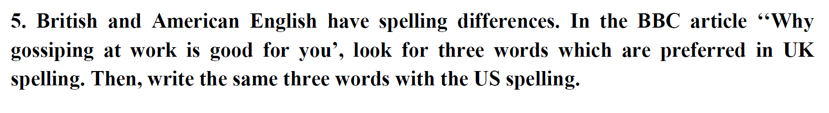

Slide 12
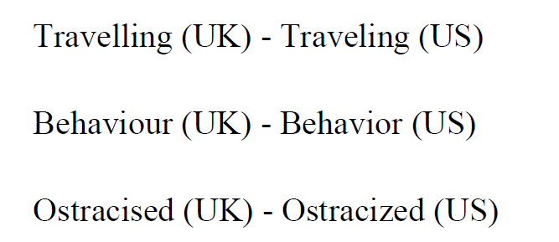

Slide 13
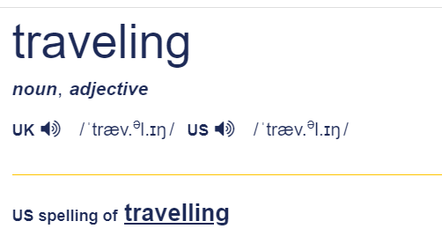
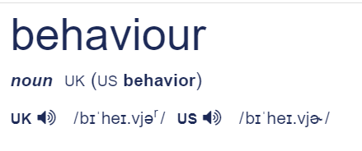


Slide 14
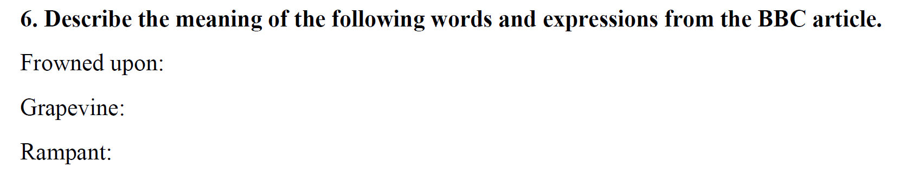

Slide 15
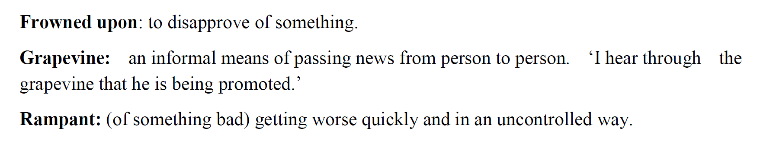

Slide 16
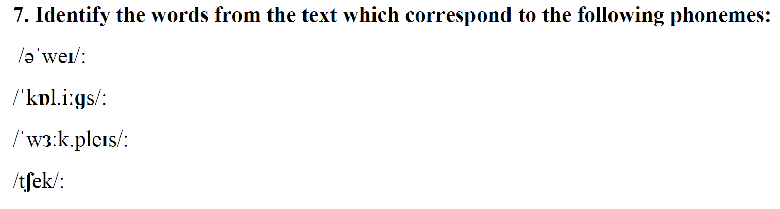

Slide 17
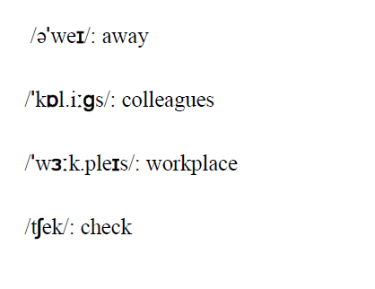

Slide 18
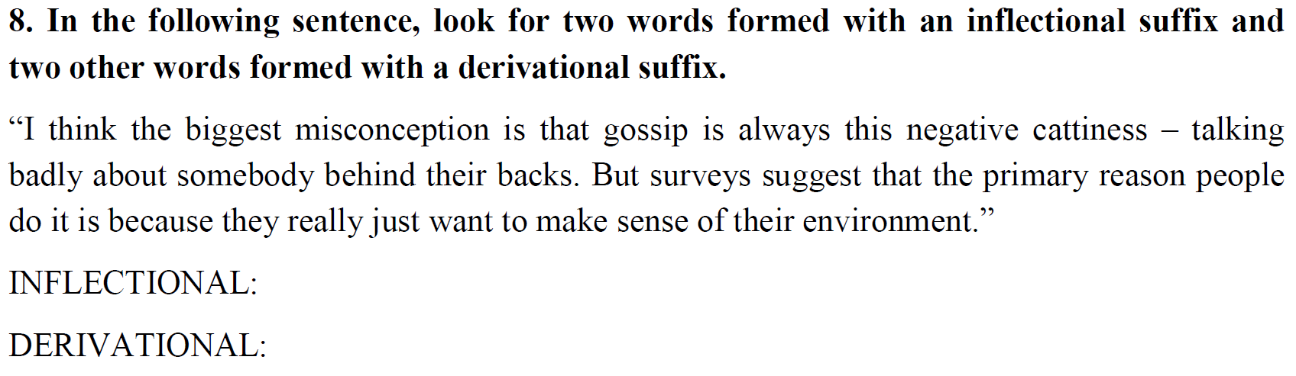

Slide 19


Slide 20
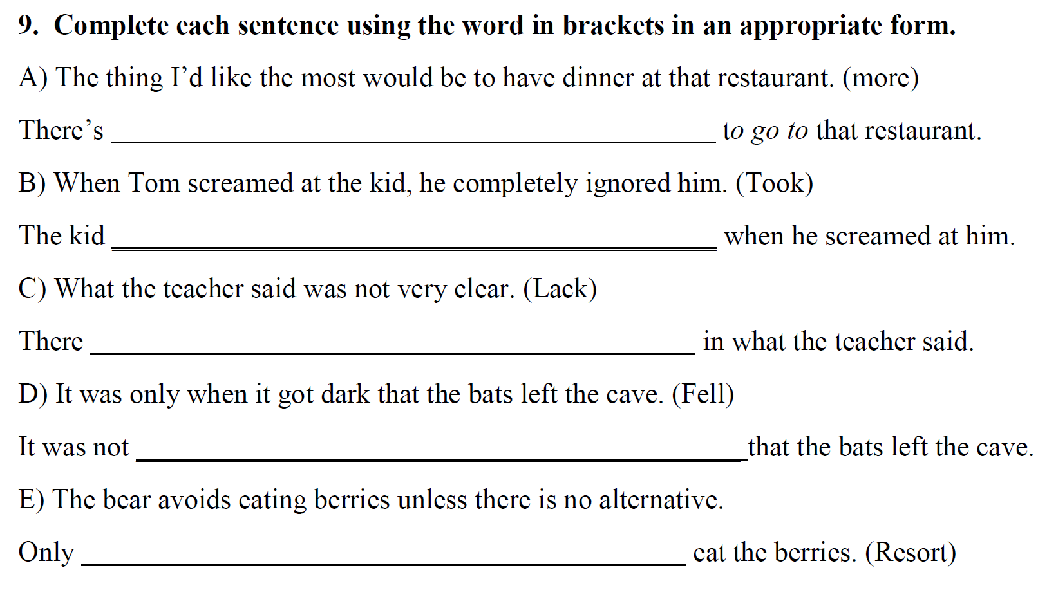

Slide 21
