Slide 1
TEMA 6
VERBS: COMPOUND VERBS, PREPOSITIONAL VERBS.
PHRASAL VERBS

Slide 2
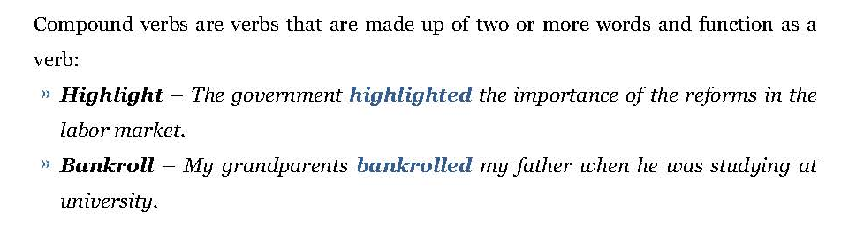
English Language III. UCJC.
COMPOUND VERBS

Slide 3

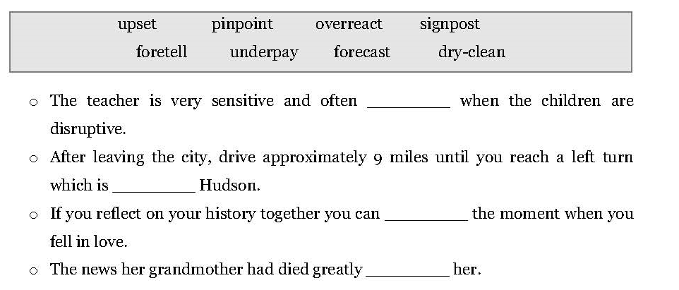
English Language III. UCJC.

Slide 4
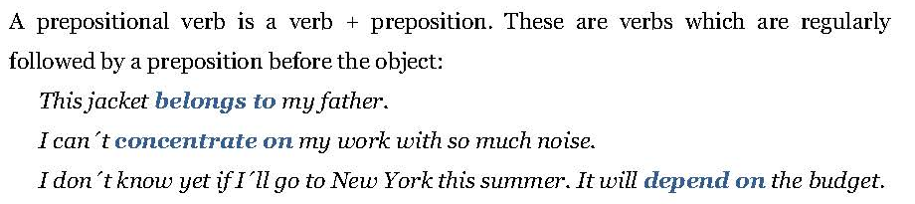
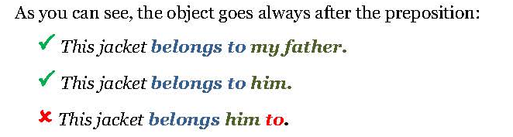
English Language III. UCJC.
PREPOSITIONAL VERBS

Slide 5
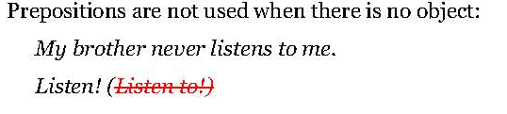
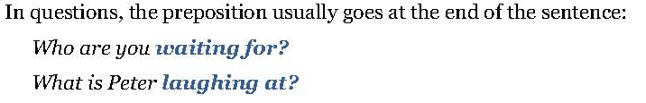
English Language III. UCJC.

Slide 6
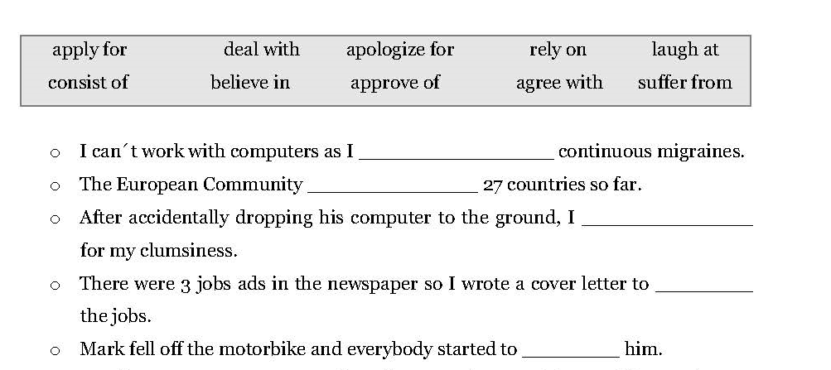
English Language III. UCJC.

Slide 7
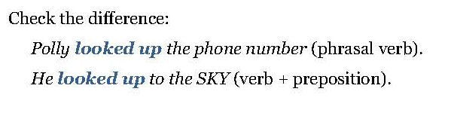
English Language III. UCJC.
PHRASAL VERBS
Phrasal verbs are usually two-word phrases consisting of verb + adverb or verb + preposition.

Slide 8
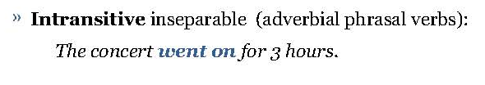
English Language III. UCJC.
Phrasal verbs can be divided into different categories:
TRANSITIVE
INTRANSITIVE

Slide 9
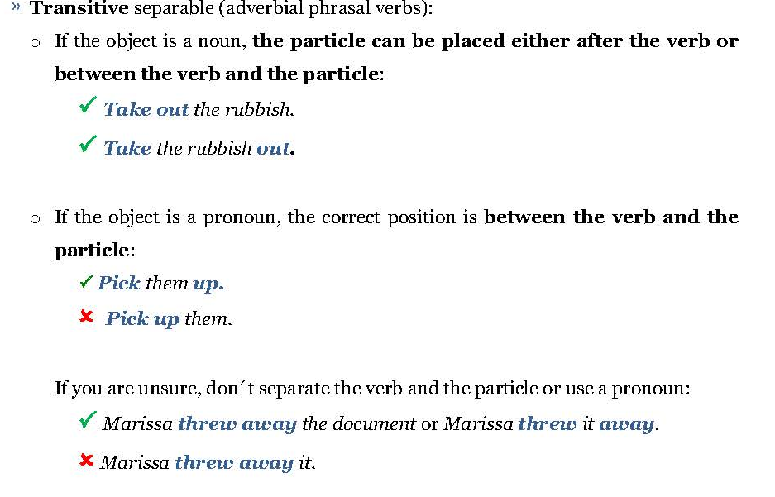
English Language III. UCJC.
TRANSITIVE PHRASAL VERBS

Slide 10
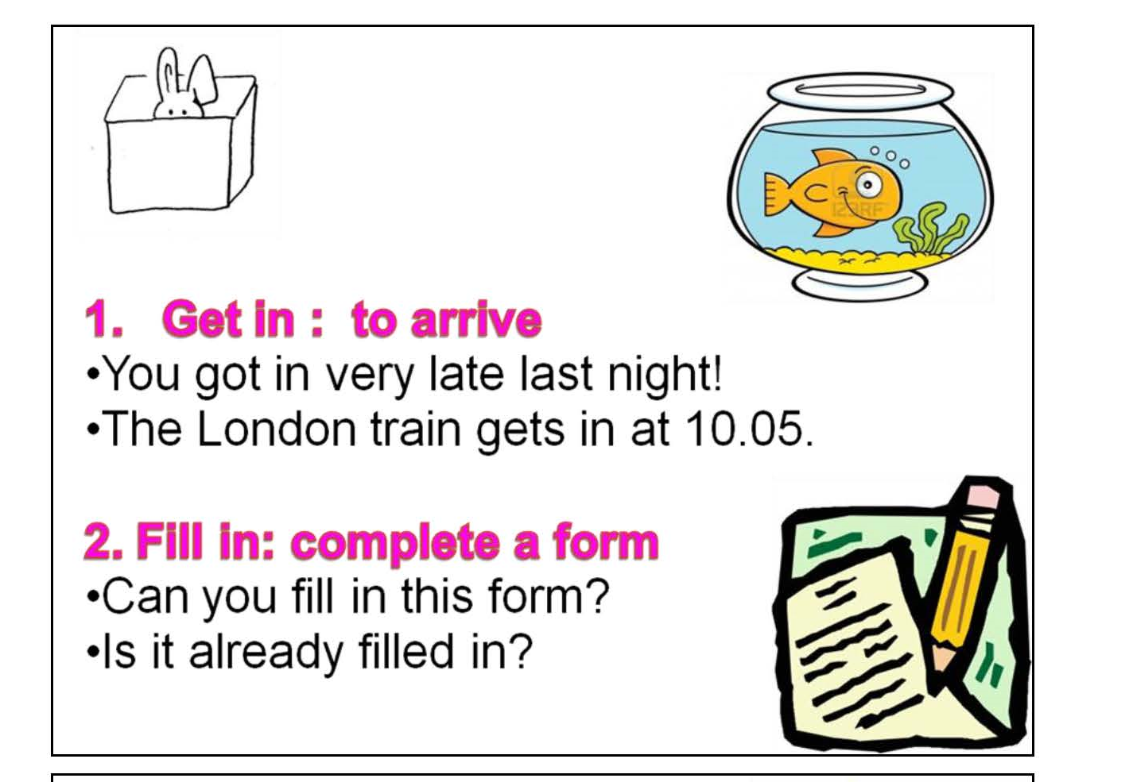
SOME TRANSITIVE PHRASAL VERBS

Slide 11
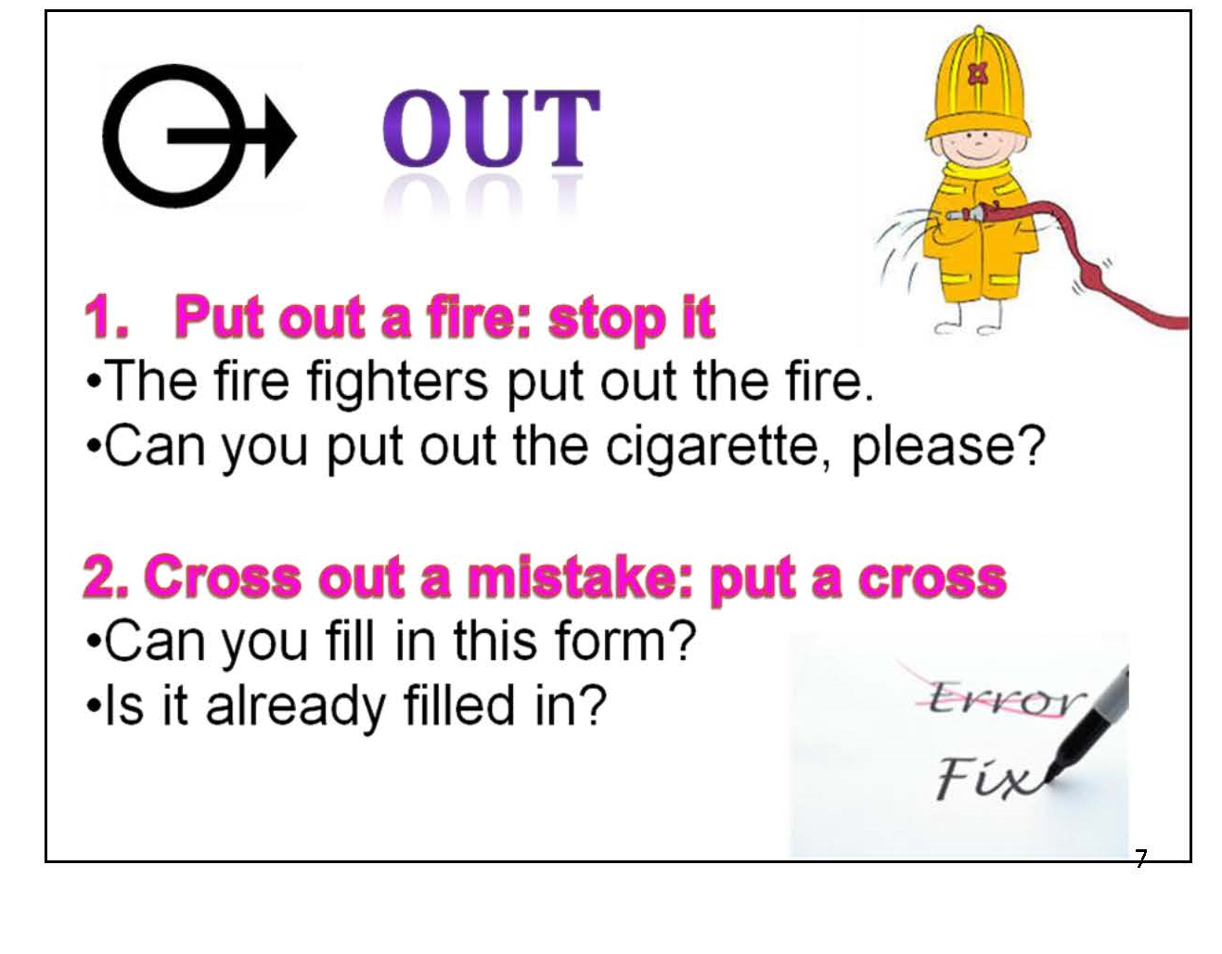
SOME TRANSITIVE PHRASAL VERBS

Slide 12
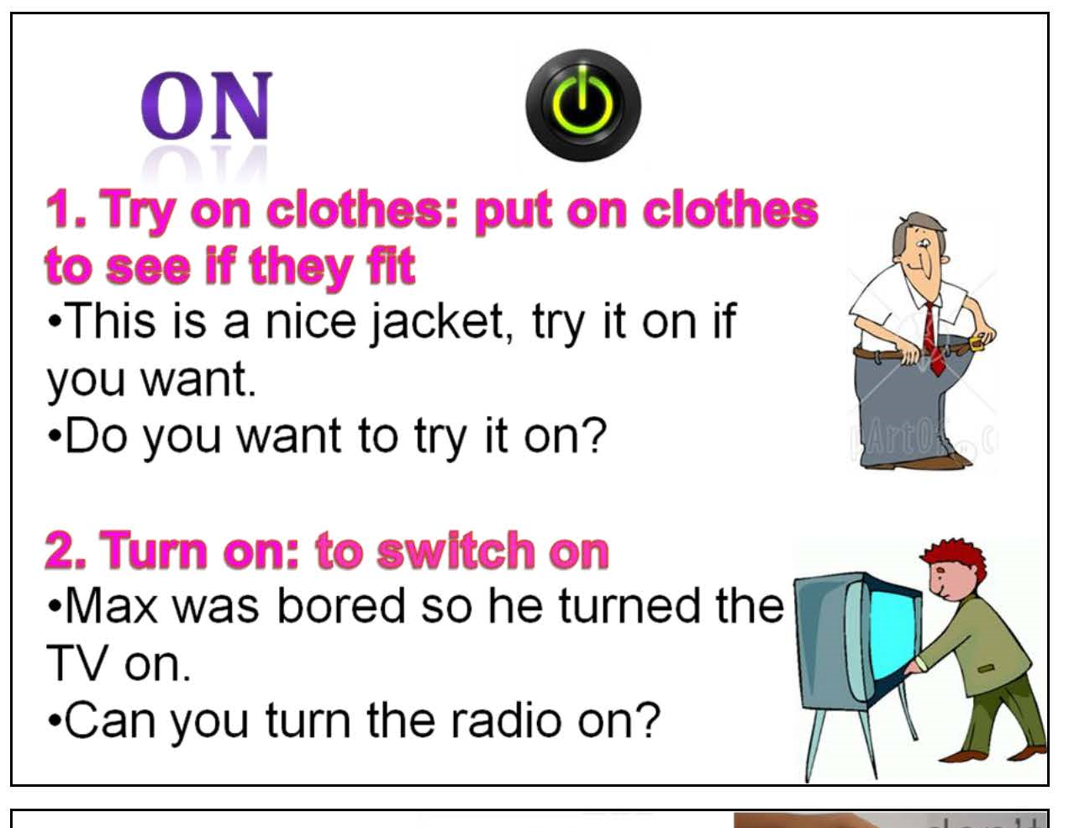
SOME TRANSITIVE PHRASAL VERBS

Slide 13
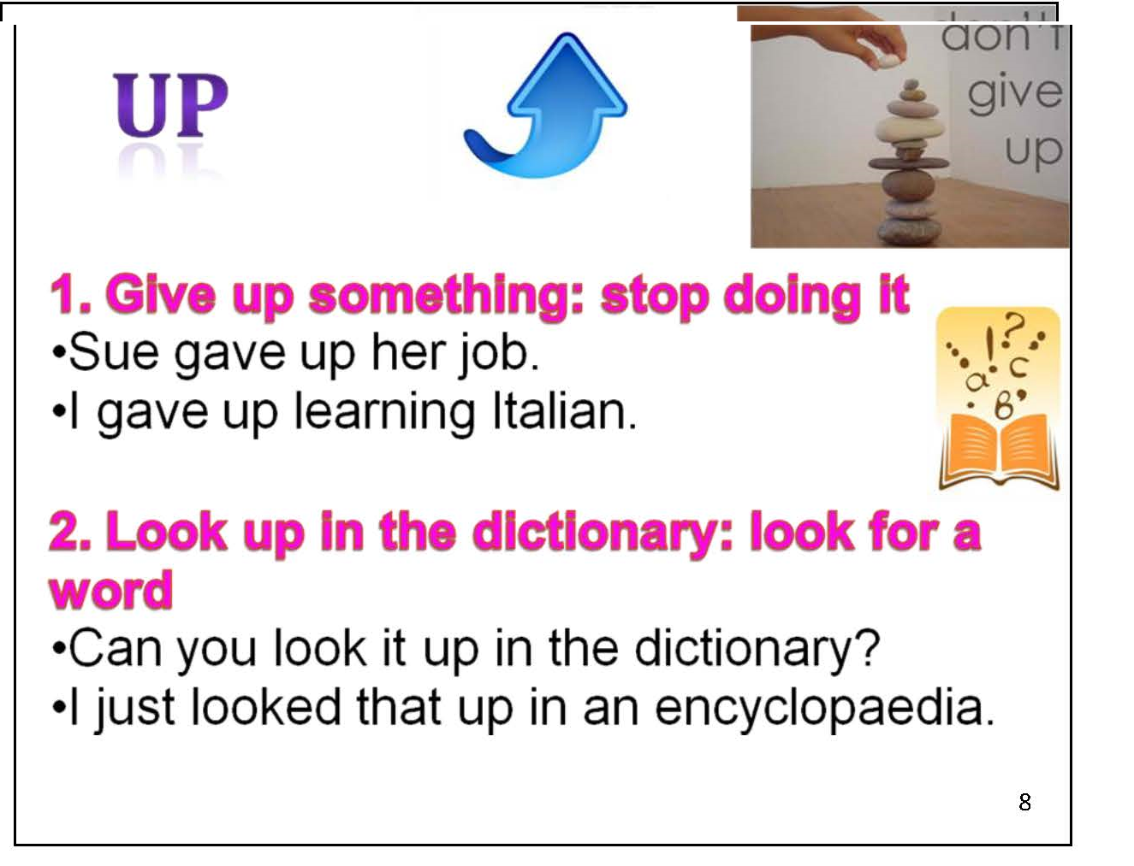
SOME TRANSITIVE PHRASAL VERBS

Slide 14
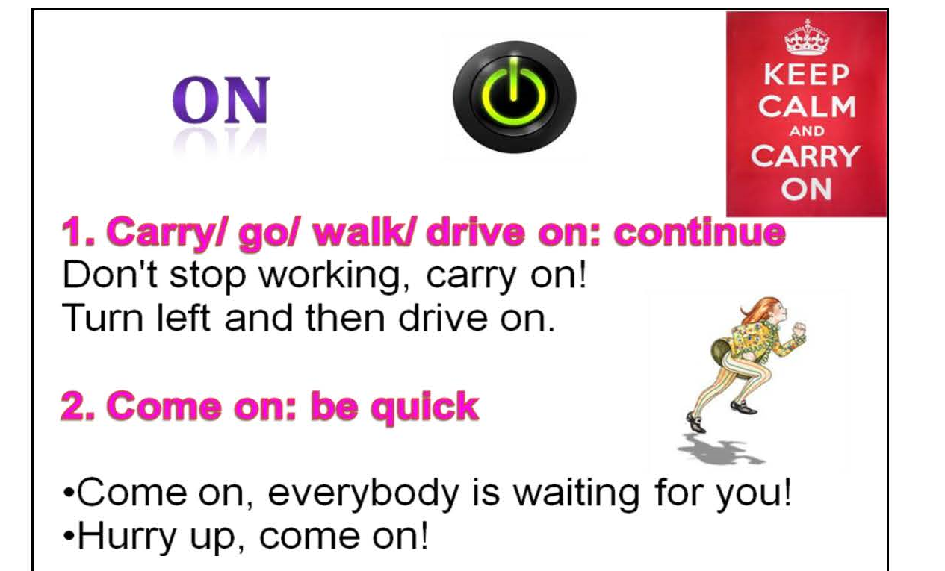
SOME INTRANSITIVE PHRASAL VERBS

Slide 15
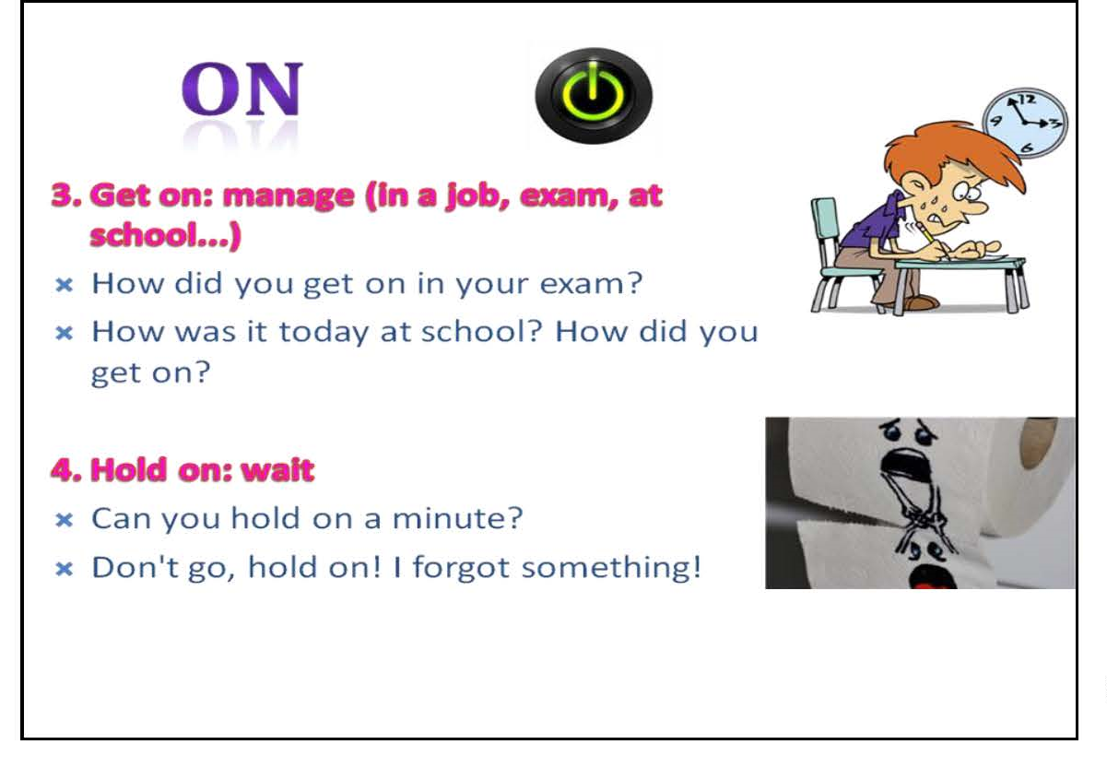
SOME INTRANSITIVE PHRASAL VERBS

Slide 16
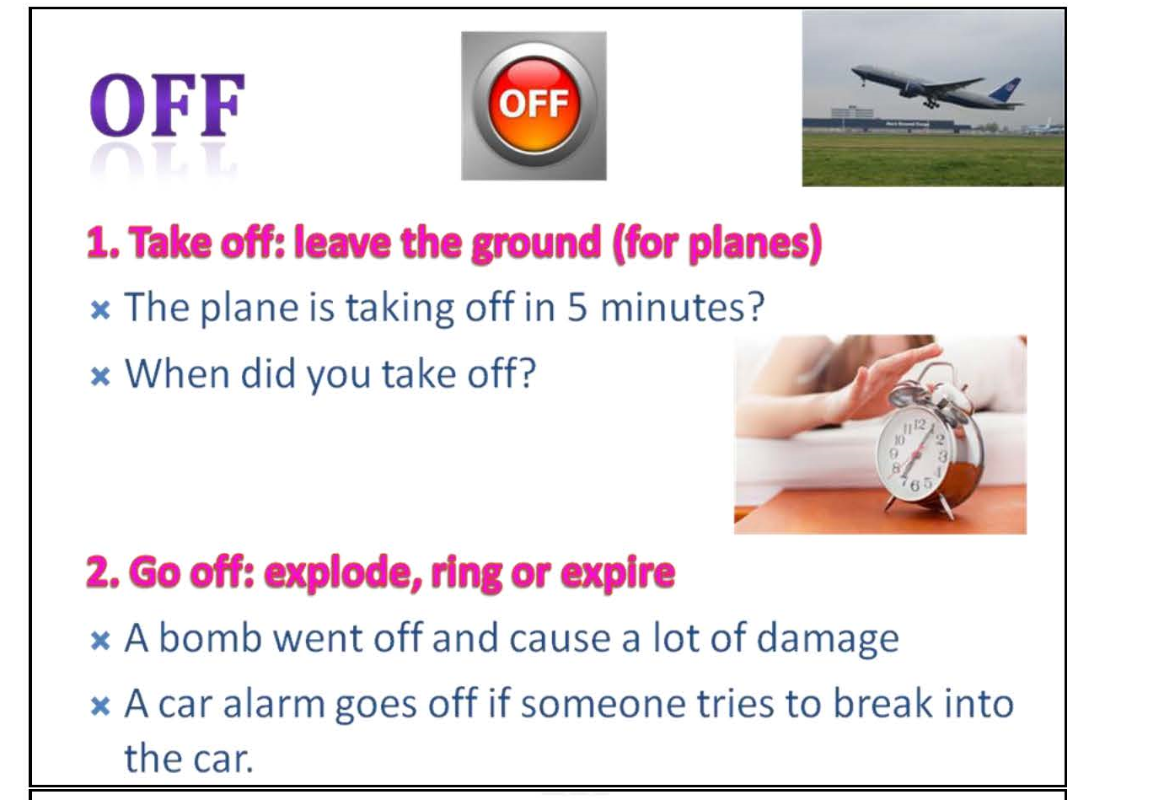
SOME INTRANSITIVE PHRASAL VERBS

Slide 17
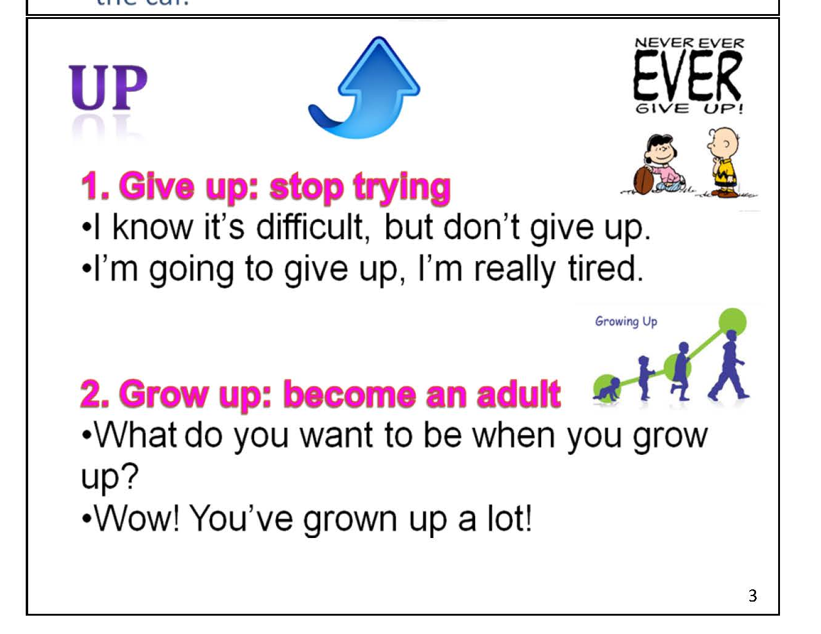
SOME INTRANSITIVE PHRASAL VERBS

Slide 18
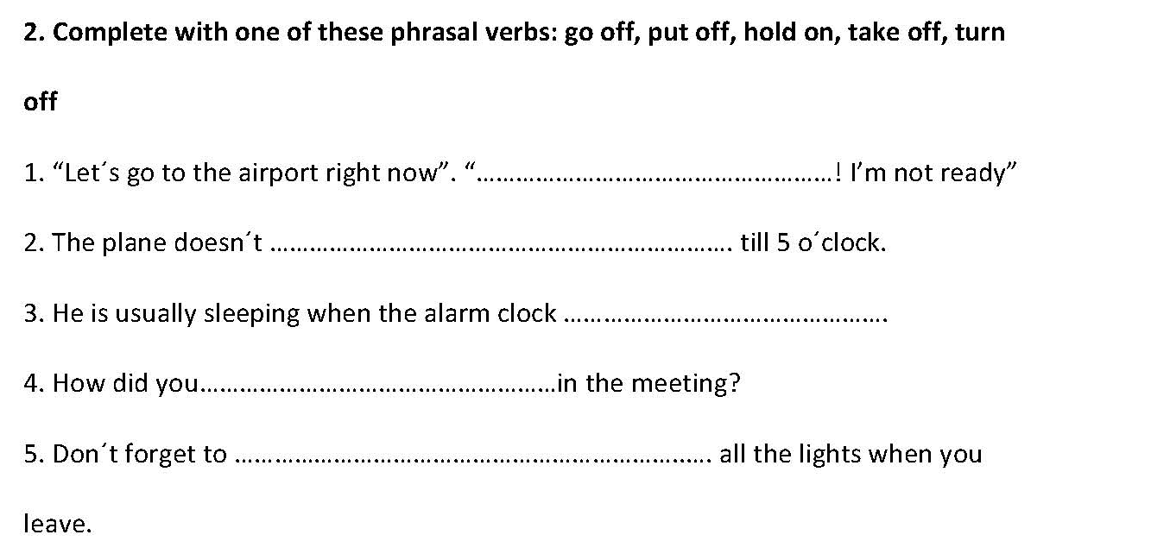

Slide 19
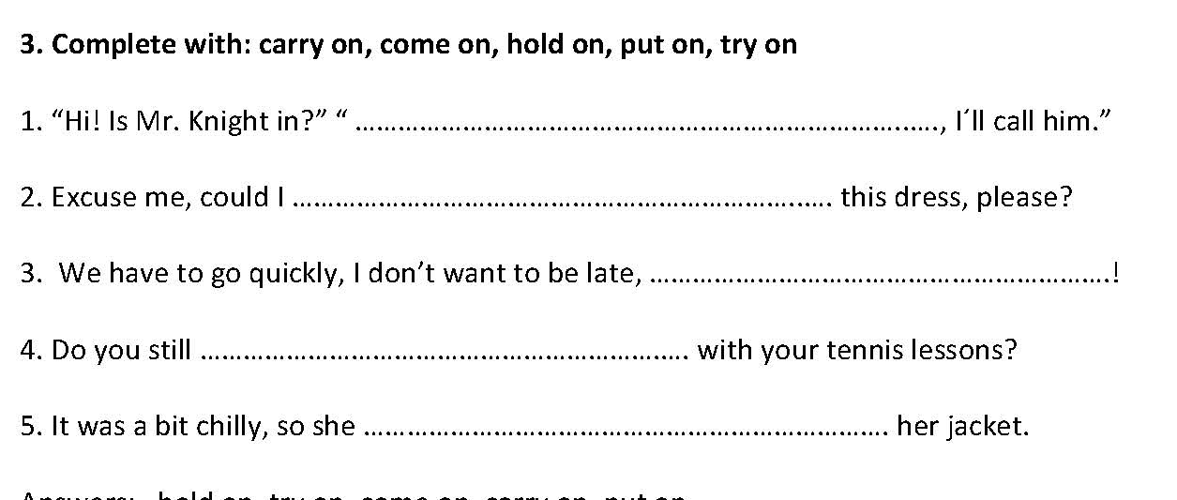
English Language III. UCJC.

