Slide 1
Tema 4
REPORTED SPEECH

Slide 2

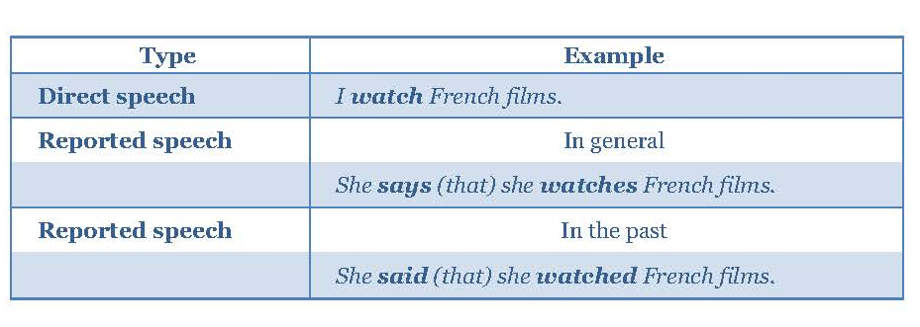

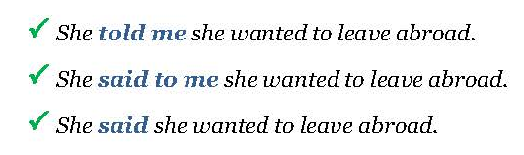
English Language III. UCJC.

Slide 3

English Language III. UCJC.
Change the following items in the sentence:
Pronouns and determines
Place and time expressions
Tenses

Slide 4

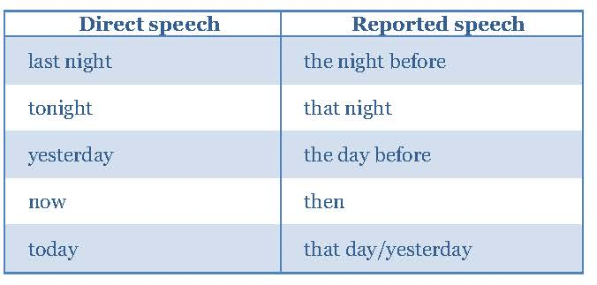
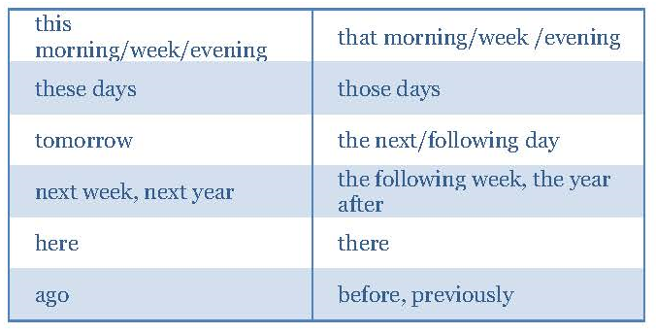
English Language III. UCJC.

Slide 5

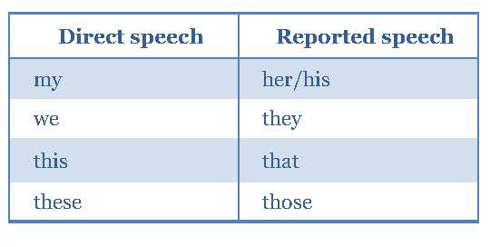
English Language III. UCJC.

Slide 6

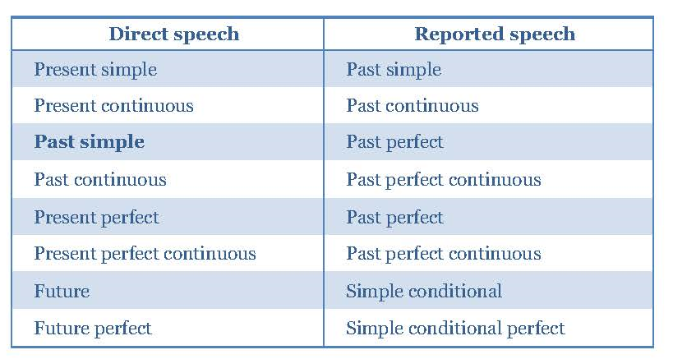
English Language III. UCJC.

Slide 7
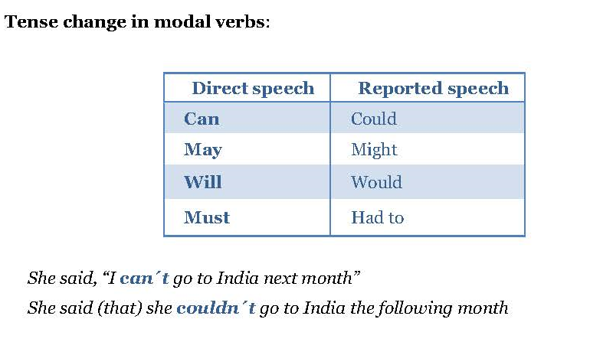
English Language III. UCJC.

Slide 8
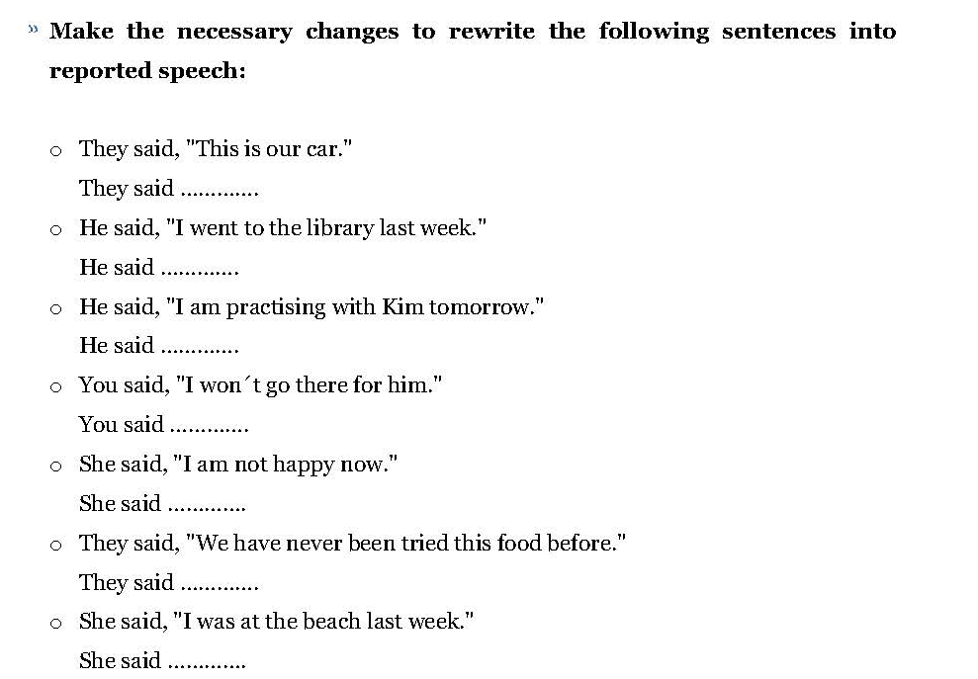

English Language III. UCJC.

Slide 9

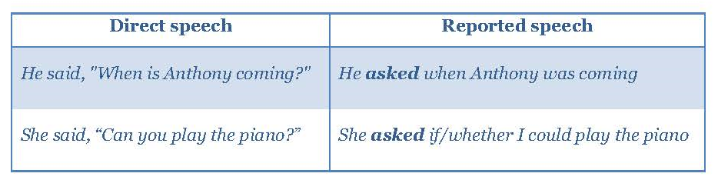
English Language III. UCJC.
QUESTIONS

Slide 10
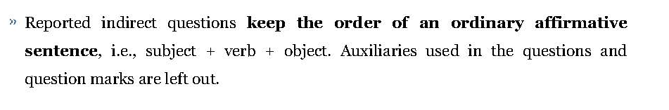
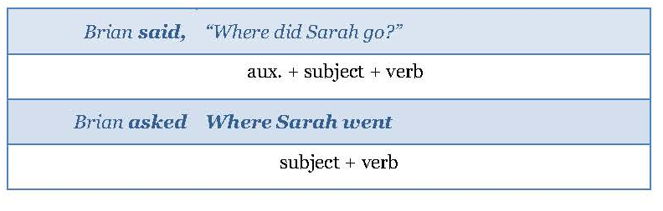
English Language III. UCJC.

Slide 11
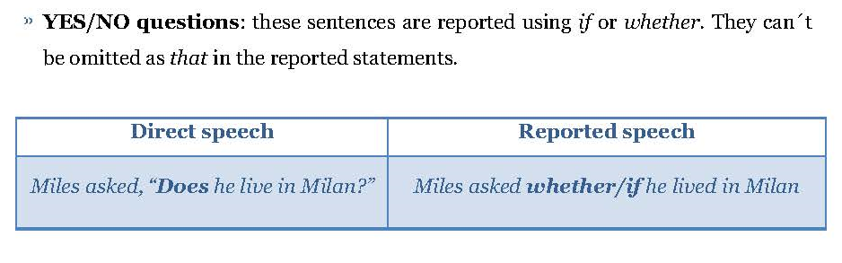
English Language III. UCJC.

Slide 12
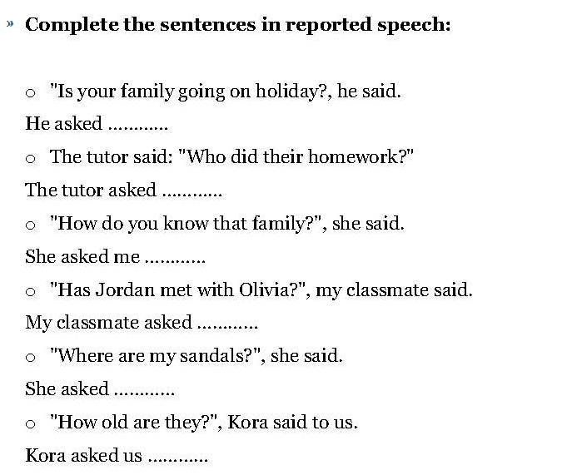
English Language III. UCJC.

Slide 13
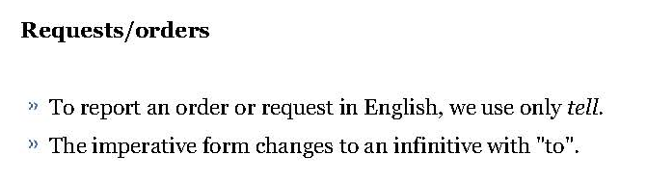
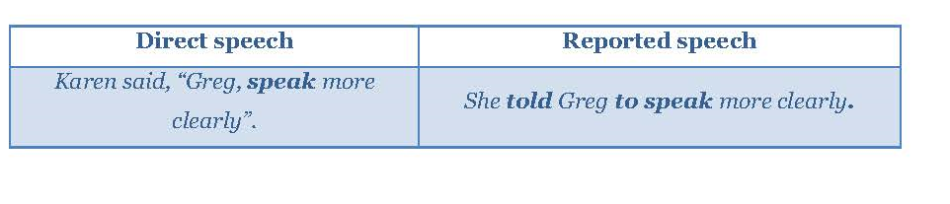
English Language III. UCJC.

Slide 14
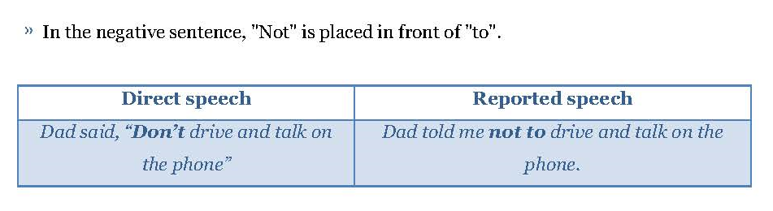
English Language III. UCJC.

Slide 15
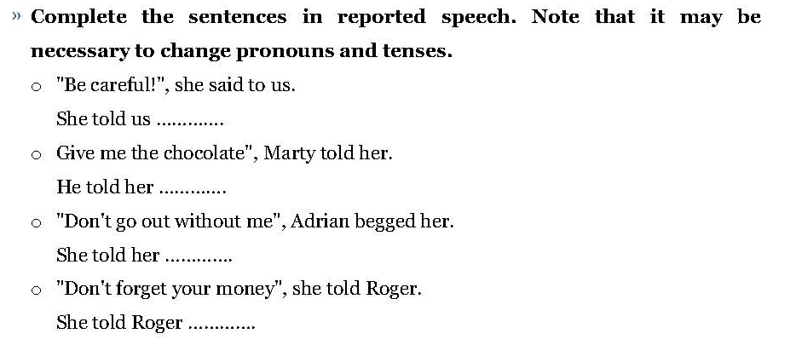
English Language III. UCJC.

